Slide 1

Hate speech moderation on Twitter
Team 3
Yizhu Liao
Anjali Hegde
Keerthi Pullela
Xema Pathak
Ashwini Rao

Slide 2
Problem statement
What is hate speech?
Online hate speech is a type of speech that takes place online (e.g. the Internet, social media platforms) with the purpose of attacking a person or a group based on attributes such as race, religion, ethnic origin, sexual orientation, disability, or gender
The flexibility that online platforms provide with respect to anonymity and permanence is why it is hard to address and act against

Slide 3
Objective
To flag and block hate speech on one of the popular social media platforms, Twitter.
Why?
Across the United States, the inflammatory and confrontational tone of political rhetoric is creeping into public discourse and polarizing the electorate. It has created massive skew in the US elections in the past. Therefore, it's critical to block hate speech to reduce the skewness.
Notes:
With the advent of social media platforms like Facebook and Twitter individuals inclined towards racism, misogyny have found an opportunity to reinforce their views on others. Over the years the viciousness of these comments has evolved to be more threatening. Across the United States, the inflammatory tone of political rhetoric is creeping into public discourse and polarizing the electorate. It has created massive skew in the US elections in the past. It is thus important to reduce this skewness. Therefore our objective for this project is to flag and block hate speech on Twitter

Slide 4
Our approach – model training
Static dataset
Building a model
Data pre-processing
Model assessment
Hate speech tweets from Kaggle
Used NLTK
Logistic regression for hate tweet flagging
Tokenization
Lemmatization
Stop word removal
Logit model Accuracy:: 94.90%
Notes:
In order to train our model we collected Hate speech tweets from Kaggle for our static dataset and built the model using NLTK package, which is popular python package for natural language processing. We applied Tokenization, Lemmatization and stop-word removal to pre-process the data to arrive at keywords before feeding it into a logistic regression model for hate tweet flagging. Our model obtained an accuracy rate of 94.9%

Slide 5
Keywords
How we selected words
Identified words that are commonly used in tweets, especially revolving around election candidates and presidency, and used them to track and mine tweets for classification
Some of the words used
petebuttigieg
democrats
democrat
impeachtrumpnow
Election2020
2020election
USElection
trump
Obama
supremacy
belikepete
republicans
democrats
Notes:
These are some of the common keywords in tweets, revolving around US elections. We used them to track and mine tweets for classification.

Slide 6
Our approach – model implementation on live tweets
Hate tweet flagging model
Identify hate tweets and accounts that generate hate content
Streaming data from Twitter
Notes:
For our streaming dataset we Used Twitter mining to extract 1.5 Lakh tweets over a duration of 45 min, and performed analysis on this file size of 1GB

Slide 7
Workflow
Python IDE
(Jupyter)
Hadoop (MapRed)
Hive
Tableau dashboard
Data pre-processing
Create a Hate tweet flagging model using logistic regression
Storing processing & analysing the data
Divides workloads across multiple nodes
Analysing large data sets (Partition columns, Sampling, Buckets)
Easy data ETL (Extract Transform and Load)
Visualize the data to demonstrate the percentage of hate speech on twitter and that of by user
Notes:
-Performed modelling in Jupyter IDE
The output file was fed into Mapper and Reducer to perform relevant operations for analysis
For each mapper and reducer output, we loaded the data in Hive for further table manipulations using SQL query
Finally we connected the Hive tables to the Tableau for visualizations

Slide 8
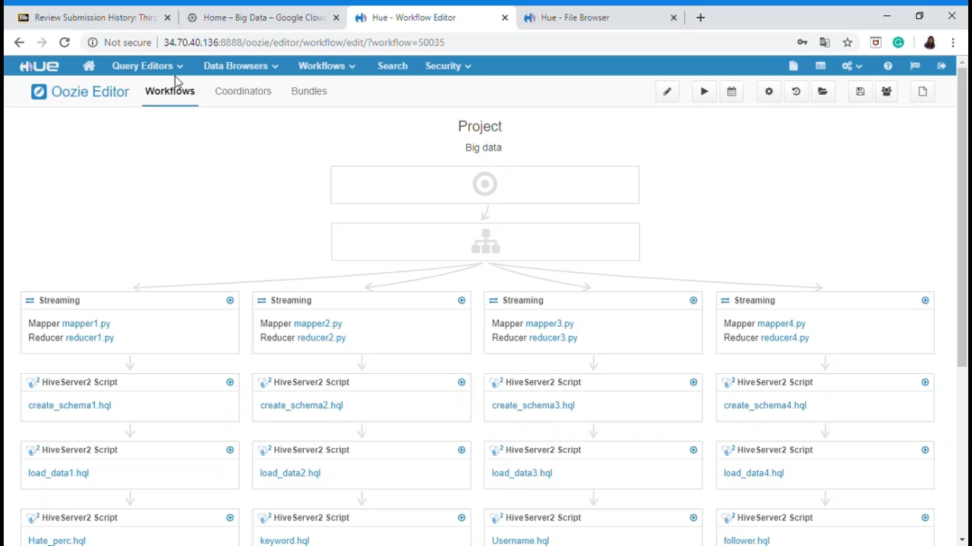
Notes:
We developed and implemented the workflow on Oozie. As you can see, the 4 mappers and reducers we designed, run parallelly on 4 different tasks. Each mapper reducer creates files that are inputs to the create, load and processing queries. The final output from each stream, then feeds into separate visualizations and tabs of our tableau dashboard.

Slide 9
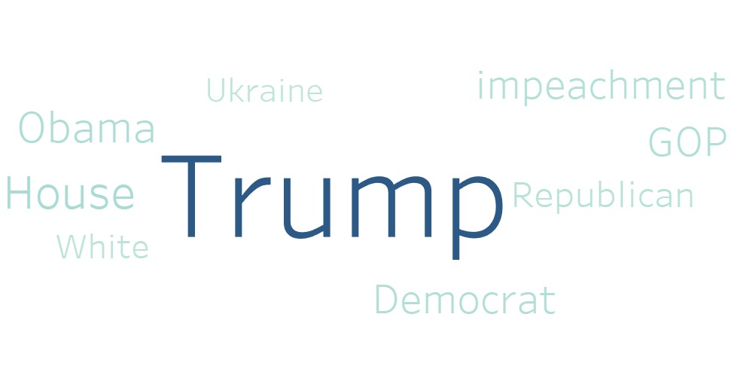
Insights
Notes:
Some of the most prominent words used in the tweets are as seen in the word cloud

Slide 10
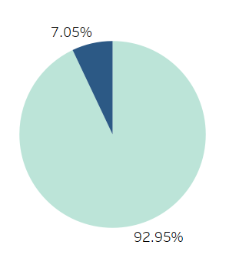
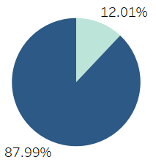
Insights
7.05% of the tweets scraped were classified as hate speech
12.01% of the users tweeted hate-speech content
70.5 million hate tweets if the same percentage is attributed to 2016 elections
10 times the population of Indiana
Notes:
Some of the insights we obtained from our model were that 7.05% of the overall tweets scraped were classified as hate speech, if the same is extrapolated to 2016 US elections it comes to 70.5 million hate tweets, which is almost 10 times the population of Indiana. The scale is humongous. Even if a user posts 5 hate-speech tweets in an hour, it will translate to 120 tweets in a day. Considering 12.01% of the users posting such content, there will be more than 10 million hate-speech tweets regarding US elections just in a day.

Slide 11
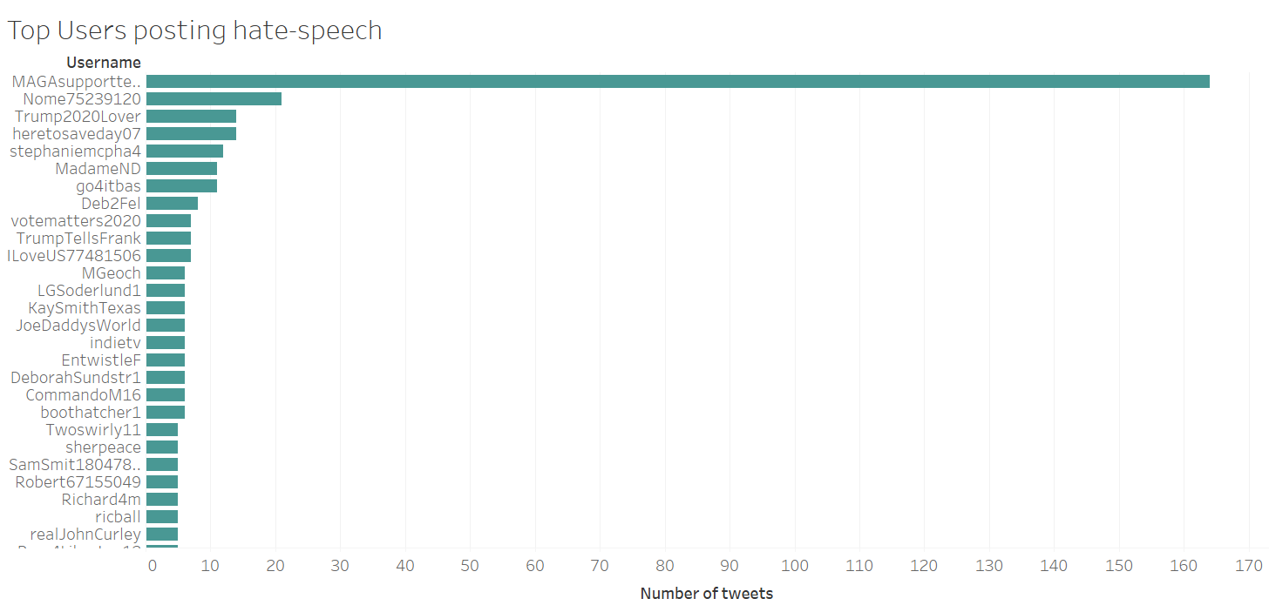
Insights
Notes:
This insight throws light on the top users posting hate speech on twitter, twitter could use this data to flag or block these twitter handles.

Slide 12
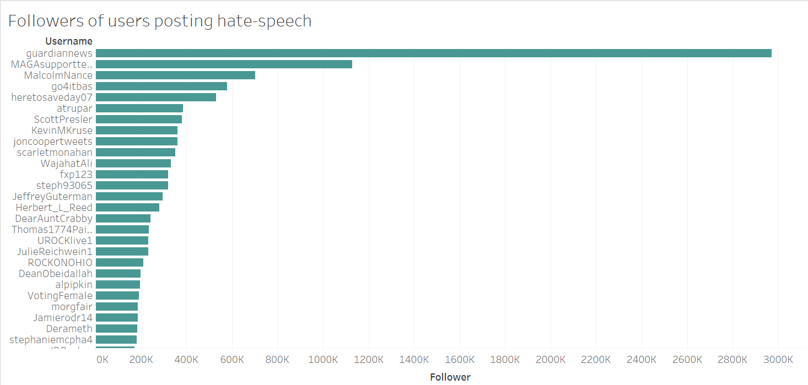
Insights
Notes:
The top 20 users posting the hate-speech content have followers that run into thousands. Such widespread reach of these users can further instill the skewed sentiment for the US elections. Our model thus helps reduce this skewness and control hate speech on twitter.

Slide 13
Thank You!

